Slide 1
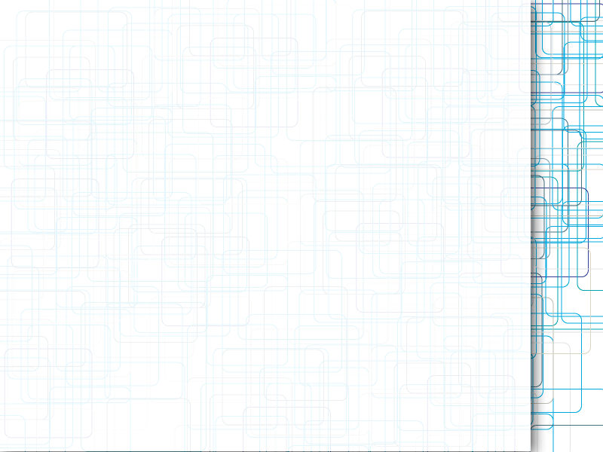
Data integrity on storage devices

Slide 2
Agenda
Background
Causes for data loss
Possible solutions
RAID
RAID disadvantages
ZFS
ZFS disadvantages
Btrfs

Slide 3
Background
Increasing amount of data
Non mission critical data
Write Once Read Many
Low Budget
Abstraction

Slide 4
Causes for data loss
Mechanical failure
Mechanical error
Firmware errors
Software errors
Bit rot

Slide 5

Storage Errors
Torn Write
  Only part of a block is written
  Some sectors are lost
  Write returns success code
Lost Writes
  Write returns success code
  Data not reflected on disk
A
Write B
Success
A
Write B
Success

Slide 6
Storage Errors (Cont’d)
Misdirected Writes
  Write goes to wrong location
  (either wrong block or wrong disk)
  Combination of lost write
  and corruption
A
B
A’
Overwrite A→ A’
Success

Slide 7
Possible (hand made) solutions
Save everything twice on same device
  Pros: simple and cheap to implement
  Cons: disk failure still causes data loss,
    hard to maintain
Save everything twice on different devices
  Pros: simple to implement, survive disk failure
  Cons: hard to maintain
Biggest con: no indication for file inconsistency

Slide 8
RAID
Redundant Array of Independent Disks
Abstraction
Support via dedicated controllers connected to expansion slots
(or most common motherboards...)
Comes in many flavors

Slide 9
RAID Levels (Flavors)
RAID 0 – performance, no redundancy
RAID 1 – redundancy, cost per byte is doubled
RAID 4 – redundancy by parity
RAID 5 – redundancy by distributed parity,
better performance over RAID4
RAID 6 – RAID5 with two parity disks

Slide 10
RAID 5 Disadvantages
Drives must be identical
Replacements must be identical to original drive
Expensive controllers
Propriety implementation
(failed controller must be replaced with identical controller)
Software RAID costs CPU
Recovery consist of full array rebuilding

Slide 11
RAID 5 Disadvantages (cont.)
RAID cannot detect partial disk failures:
  Corruptions
  Torn writes
  Lost writes
  Misdirected writes
RAID only protects against
  Complete disk failures
  Errors reported by the disk

Slide 12
RAID 5 Write Hole
Stripe: a concurrent series of blocks
When writing data, parity of the stripe must be recalculated
RAID assumes that writes are atomic.... they are not...
During a write the parity or the data might remain unchanged
During a recovery data will be deleted
Can be solved with NVRAM

Slide 13
A software solution is required

Slide 14
Maybe a file system solution?

Slide 15
What about the good old NTFS?
No data checksumming
File system has no problem giving you corrupted data

Slide 16
ZFS
A new file system by Sun
Data integrity by checksumming throught the entire tree
Errors are corrected on-the-fly
Can save n copies of data
RAIDZ and RAIDZ2
Logical structure by pools

Slide 17
ZFS (con.)
Copy-on-write followed by atomic reference swap
Variable stripe width eliminates the write-hole with RAIDZ

Slide 18
ZFS Disadvantages
High RAM requirements due to caching
Devices in pool must be the same or larger
Will grow only when all devices are replaced
Available on SunSolaris and FreeBSD
Licensing issues with Linux

Slide 19
Alternatives
Btrfs
  Linux native
  Still in beta

Slide 20
Sources
Standard RAID levels
http://en.wikipedia.org/wiki/Standard_RAID_levels
RAID 5 write hole:
http://en.wikipedia.org/wiki/RAID_5_write_hole
ZFS: http://en.wikipedia.org/wiki/ZFS
End-to-end Data Integrity for File Systems: A ZFS Case Study:
www.usenix.org/event/fast10/tech/full_papers/zhang.pdf
Jeff Bonwick's Blog: http://blogs.oracle.com/bonwick/entry/raid_z

